Slide 1

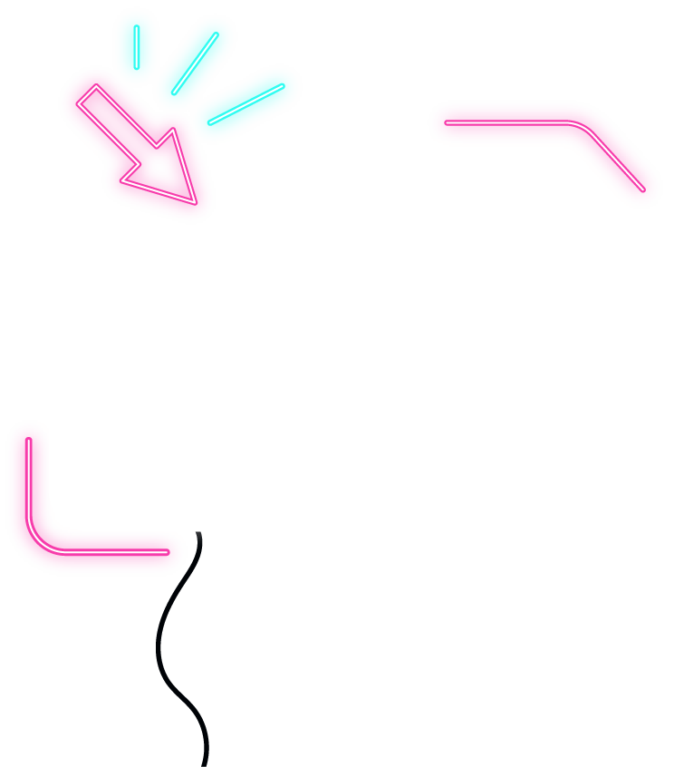




GESTURE RECOGNITION
Using
TensorFlow Lite
CNN
TEAM-J(10)

Slide 2

A SRINIVAS
D KARTHIK
M KAUSHIK
S VIJAI
OUR TEAM
CB.EN.U4AIE19010
CB.EN.U4AIE19020
CB.EN.U4AIE19036
CB.EN.U4AIE19068

Slide 3





GESTURE RECOGNITION
TENSORFLOW LITE
TABLE OF CONTENTS
QUANTIZATION
CODE

Slide 4

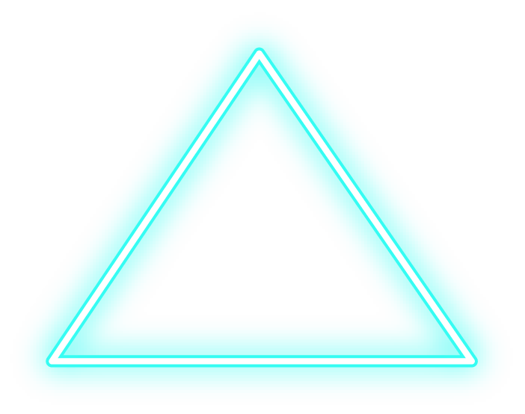
INTRO
The Hand Gesture Recognition Database is a collection of near-infrared images of ten distinct hand gestures. In this presentation we use end-to-end deep learning to build a classifier for these images.

Slide 5
01
GESTURE RECOGNITION

Slide 6


GESTURE RECOGNITION
Gesture recognition is a type of perceptual computing user interface that allows computers to capture and interpret human gestures as commands. The general definition of gesture recognition is the ability of a computer to understand gestures and execute commands based on those gestures

Slide 7

GESTICULATION
LANGUAGE-
LIKE GESTURES
TYPES OF GESTURES
PANTOMIMES
SIGN LANGUAGES
Spontaneous movements of the hands and arms that accompany speech
Gesticulation that is integrated into a spoken utterance, replacing a particular spoken word or phrase
Gestures that depict objects or actions, with or without accompanying speech
Linguistic systems, such as American Sign Language, and other languages which are well defined.

Slide 8
HAND GESTURE RECOGNITION
Hand gestures are the most common forms of communication and have great importance in our world. They can help in building safe and comfortable user interfaces for a multitude of applications. Various computer vision algorithms have employed color and depth camera for hand gesture recognition, but robust classification of gestures from different subjects is still challenging. We did an algorithm for real-time hand gesture recognition using convolutional neural networks (CNNs). The proposed CNN achieves an average accuracy of 98.76% on the dataset comprising of 10 hand gestures and 200 images for each gesture.

Slide 9
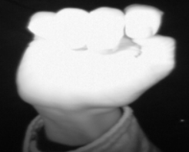
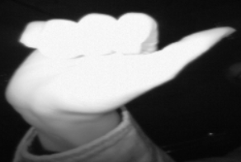
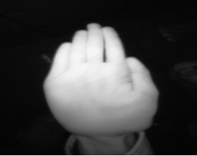
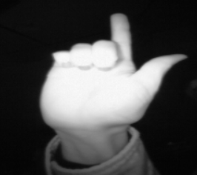
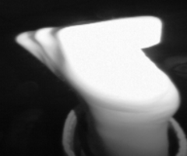
GESTURES CONSIDERED IN OUR DATASET
LETTER L
FIST MOVED
FIST
THUMB
PALM

Slide 10
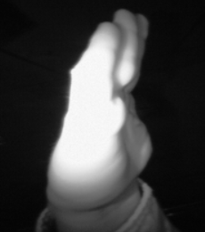
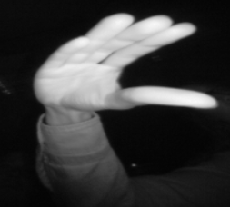
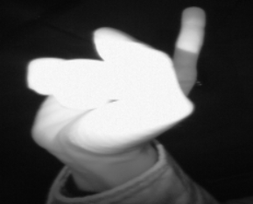
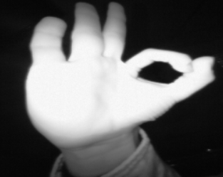
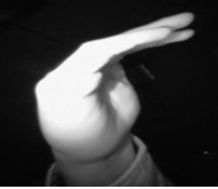
GESTURES CONSIDERED IN OUR DATASET
LETTER C
OK
INDEX
PALM MOVED
DOWN

Slide 11
Hand Gesture Recognition
APPLICATIONS
Gaming interface
Image Controlling and Scaling
Controlling Machines

Slide 12
02
TENSORFLOW LITE

Slide 13
TENSORFLOW LITE
TensorFlow Lite is a production ready,
cross-platform framework for
deploying ML on mobile devices
and embedded systems

Slide 14
KEY FEATURES
Optimized for on-device machine learning, by addressing 5 key constraints:
Latency
Privacy
Connectivity
Size
Power consumption

Slide 15

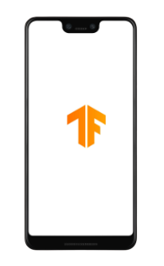
TensorFlow Lite
Android and IOS

Slide 16
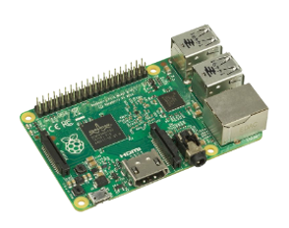
TensorFlow Lite
Embedded
Linux (Raspberry pi)

Slide 17
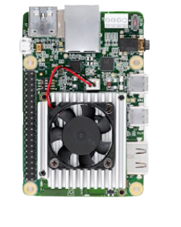
TensorFlow Lite
Hardware Accelerators

Slide 18
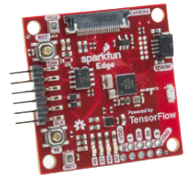
TensorFlow Lite
Microcontroller

Slide 19
03
QUANTIZATION

Slide 20


Post-training quantization
TWO TYPES OF QUANTIZATION
Training-aware quantization
More simple and easier to implement and in most cases extremely efficient
More complex that require the re-writing of the computational graph

Slide 21
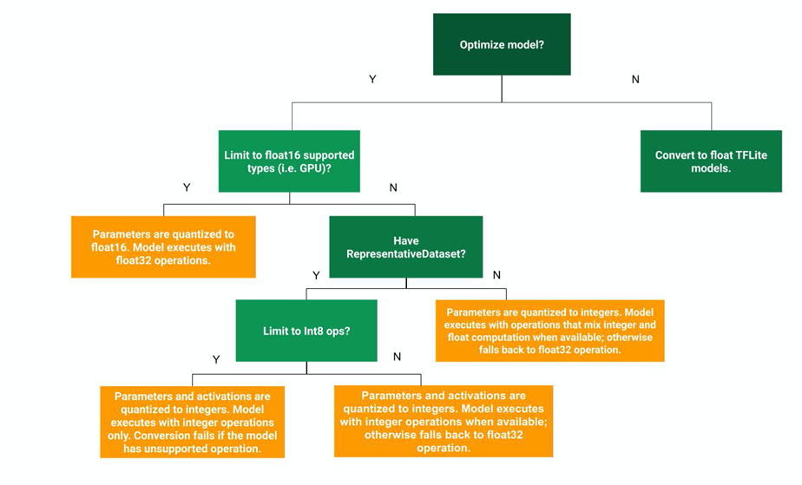
Post-training Quantization decision tree
You cannot quantize the inputs if you have never seen them.

Slide 22
Post training quantization options
TF-Lite Option | Techniques used | Benefits | Hardware
OPTIMIZE FOR SIZE | Hybrid operations | 4x smaller 2-3x speedup Accuracy | CPU
DEFAULT | Integer Quantization | 4x smaller More speedup | CPU, Edge TPU etc.

Slide 23

PYTHON IMPLEMENTATION

Slide 24
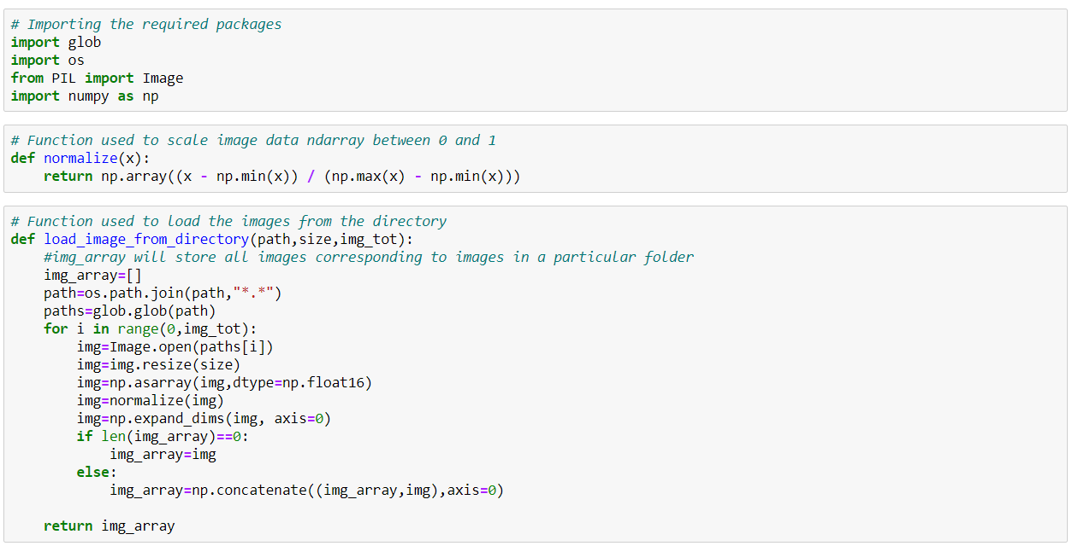
Python Code to convert images to .npy format

Slide 25
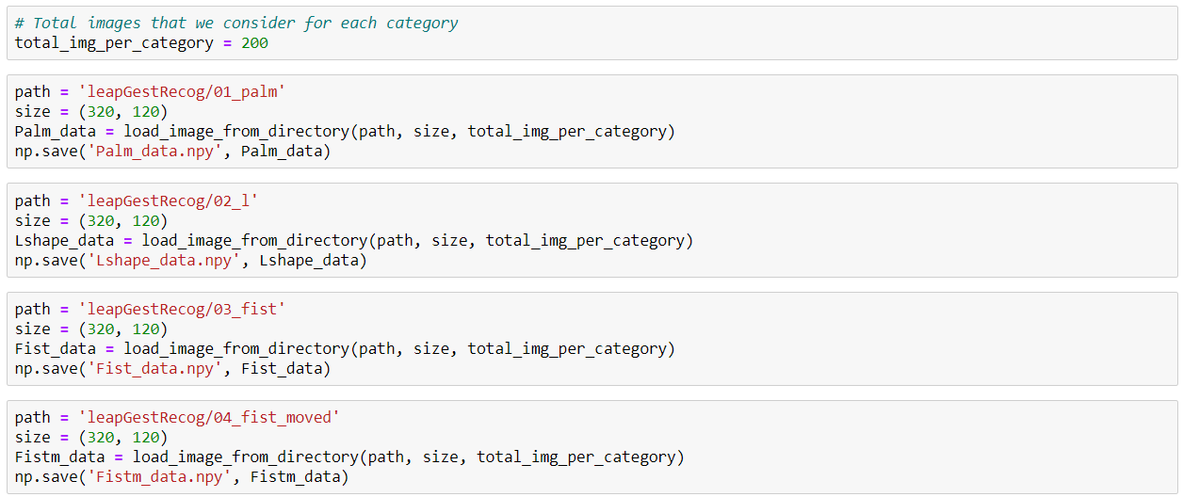
Python Code to convert images to .npy format

Slide 26
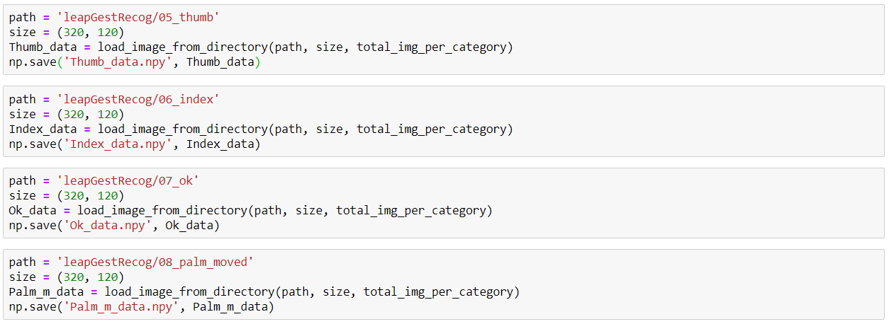
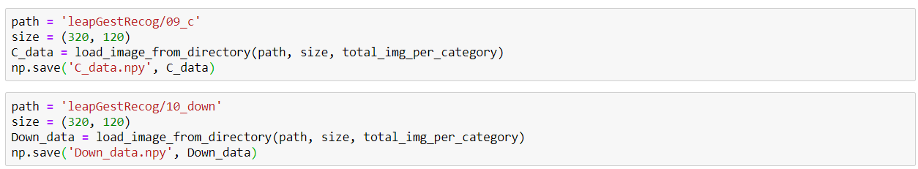
Python Code to convert images to .npy format

Slide 27
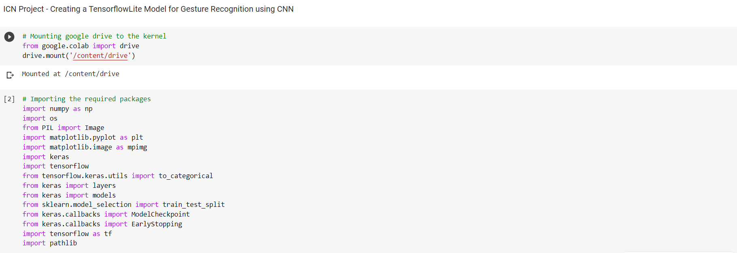
Python Code for CNN model

Slide 28
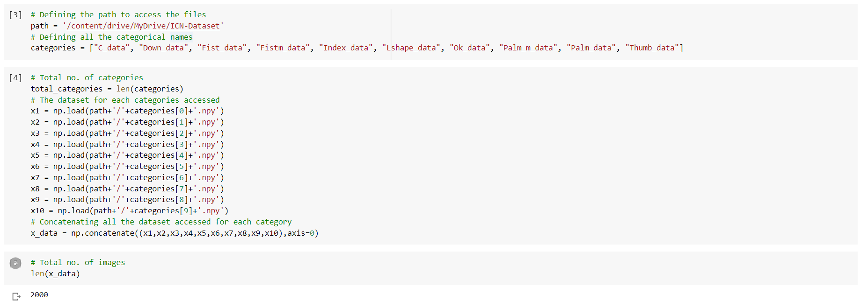
Python Code for CNN model

Slide 29
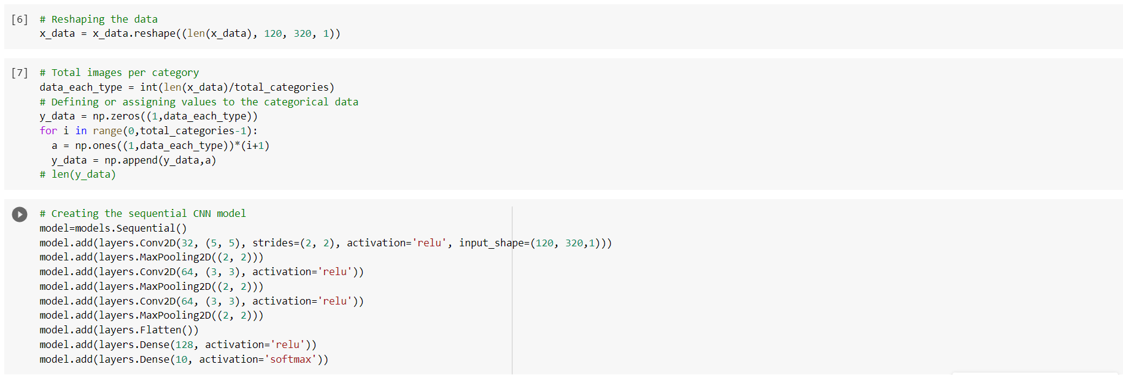
Python Code for CNN model

Slide 30
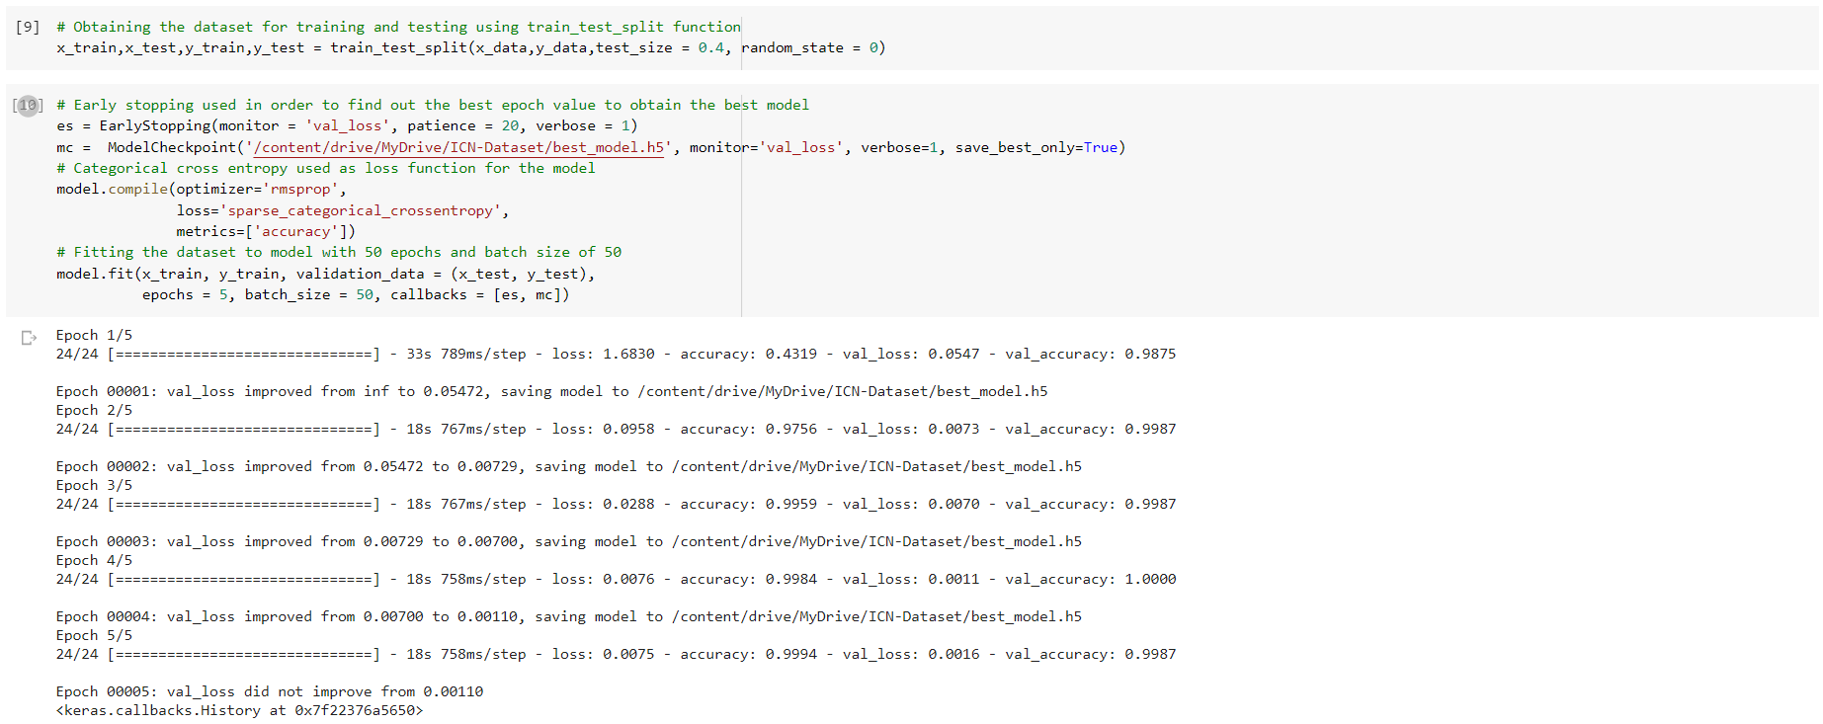
Python Code for CNN model

Slide 31
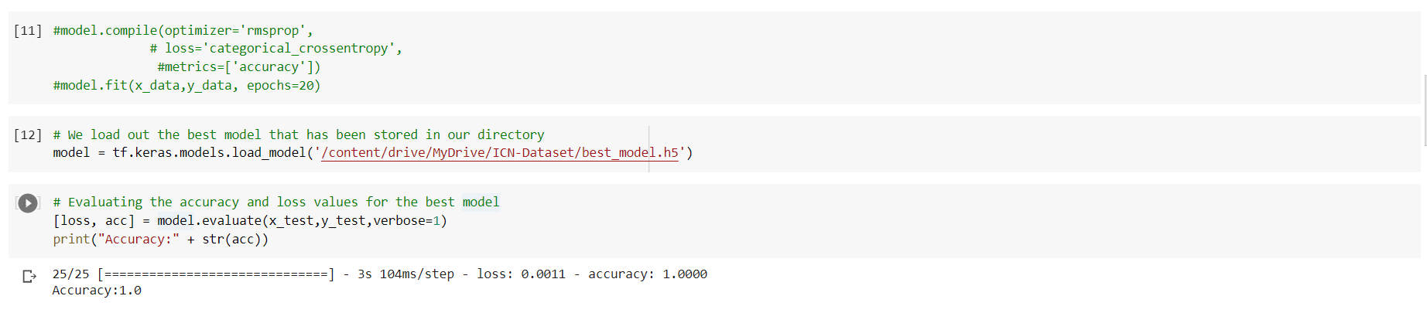
Python Code for CNN model

Slide 32
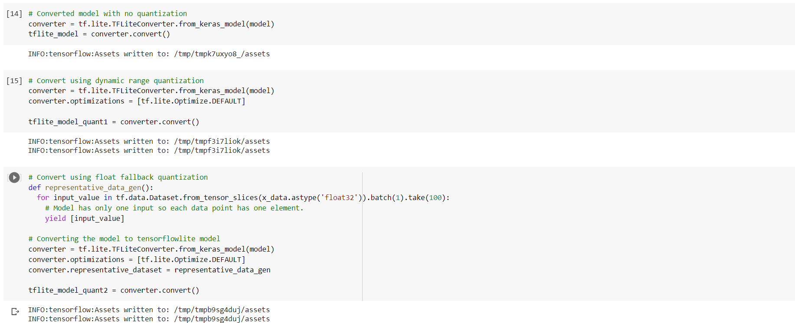
Python Code for converting model to TensorFlowLite

Slide 33
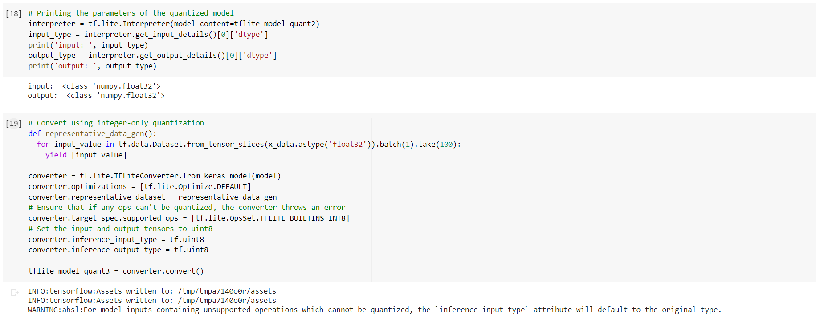
Python Code for converting model to TensorFlowLite

Slide 34
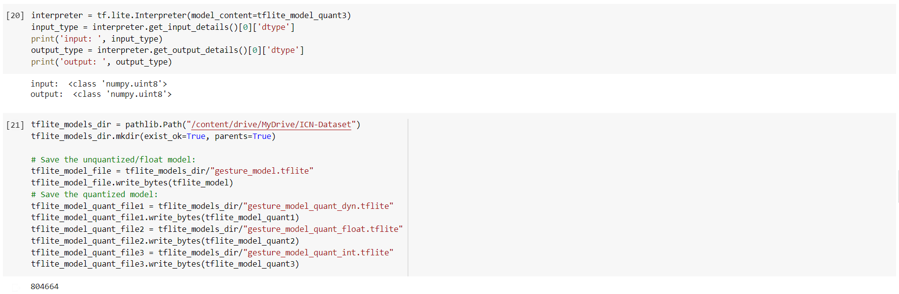
Python Code for converting model to TensorFlowLite

Slide 35
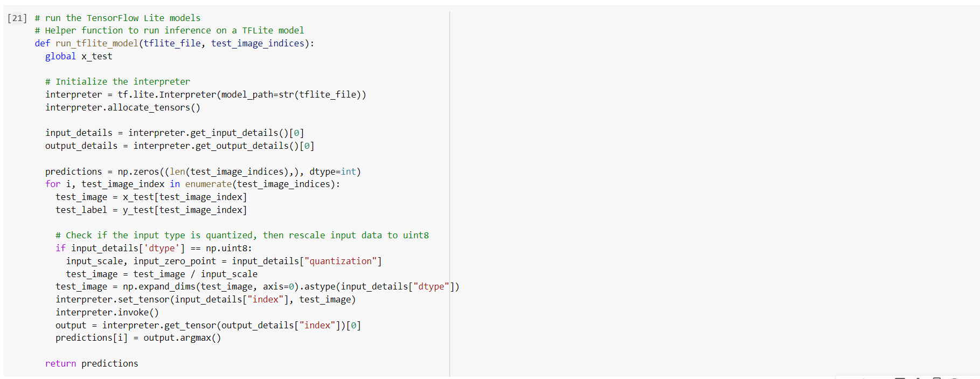
Python Code Example for loading TFLite Model and Predicting

Slide 36
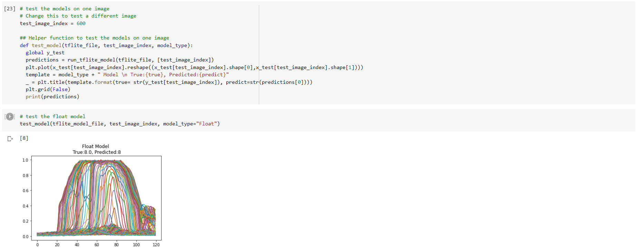
Python Code Example for loading TFLite Model and Predicting

Slide 37
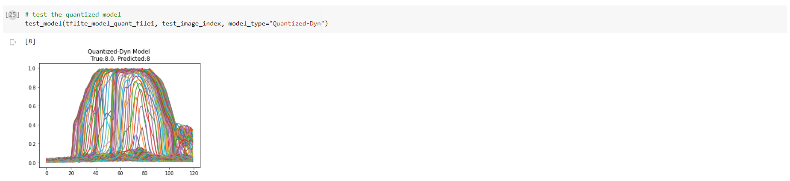
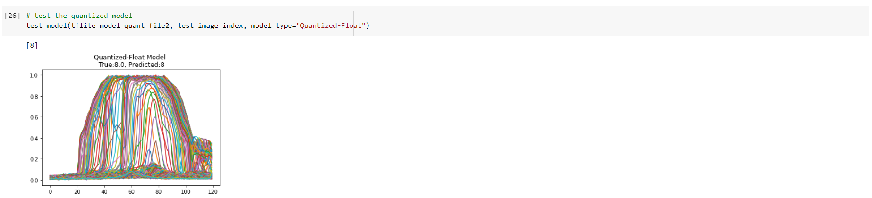
Python Code Example for loading TFLite Model and Predicting

Slide 38
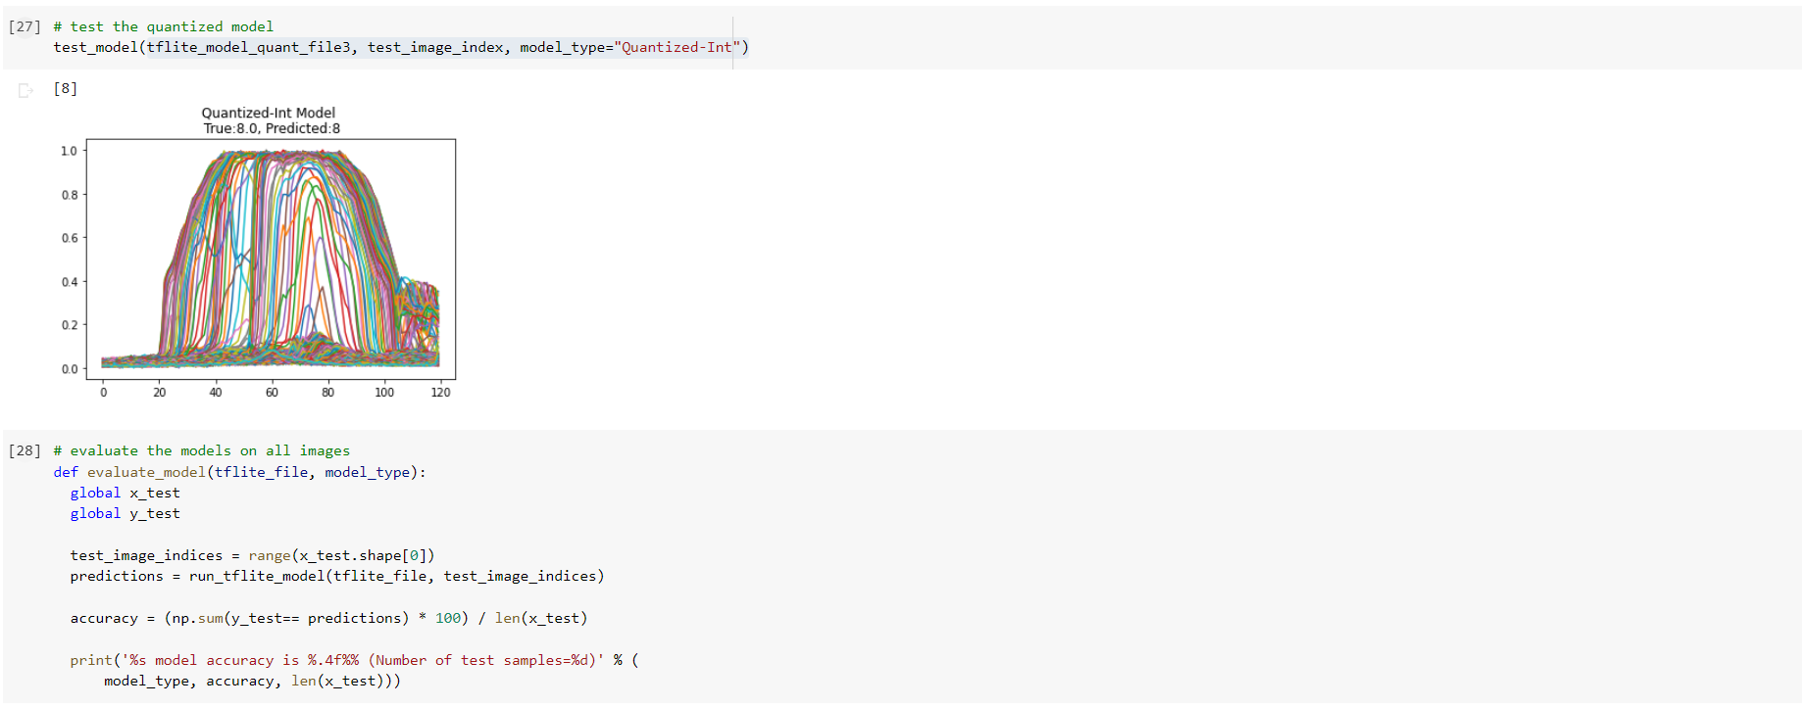
Python Code Example for loading TFLite Model and Predicting

Slide 39
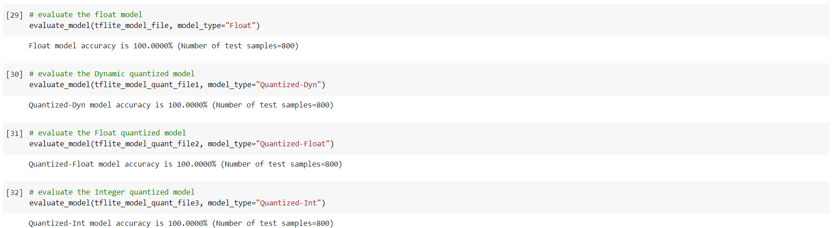
Python Code Example for loading TFLite Model and Predicting

Slide 40


THANK
YOU!!

